Slide 1
Synopsis Presentation
E-Book Marketplace
(A Student-Friendly Digital
Publishing & Earning System)
Supervised By :
Ms. Tamanna Kanwar
Presented by: Diwanshu
6231560010
Palak Chauhan
6231560020

Slide 2

Content
Introduction
Objectives
Problem Statement
Conclusion
Proposed Methodology
Tools & Technologies
Expected Outcomes
Conculsion

Slide 3
Introduction
Today, digital learning has increased a lot, and e-books are becoming more popular because they are easy to access and affordable. But when we studied existing platforms, we found some major problems. Most platforms charge high commission, focus mainly on profit, and do not support new or student authors properly. Also, all types of book categories are not available on a single platform. So, we designed the E-Book Marketplace as a student-friendly and centralized platform. It allows authors to publish easily, earn fairly, and ensures content quality using review and AI-based checking.

Slide 4
Objectives
Create a high-quality e-book library
With multiple categories
Empower students & writers
Publish easily without high costs
Ensure originality & quality
With admin review and AI assistance
Enable earning opportunities
Through a transparent commission System
Promote digital learning & reading culture
Among students and general readers

Slide 5

Problem Statement
No single platform :
Provides both quality e-books and income opportunities for students
Publishing barriers :
Many students and new authors lack resources to publish books online
Low-income potential :
Traditional e-book sites don’t give fair earnings to small creators
Quality concerns :
Many self-published e-books lack review & editing before release

Slide 6
Proposed Methodology
The system is developed using a structured Software Development Life Cycle (SDLC) approach.
Development Phases:
Requirement Analysis – Identify Admin, Author & Reader roles
System Design – Architecture & Database design
Implementation – Frontend, Backend & API integration
Testing – Unit & System testing
Deployment & Maintenance – Hosting & Performance monitoring
Presentation Layer (Frontend)
Application Layer (Backend)
Data Layer (Database & Cloud Storage)

Slide 7
How We Are Doing It (Tools & Technologies)
• Frontend
HTML, CSS, JavaScript, React for smooth UI
• Backend
PHP or Node.js with Express for server operations
• Database
MySQL or MongoDB to store user data, book info, and transactions
• Cloud Storage
AWS or Google Cloud for hosting e-book files securely
• AI Tools
API integration for grammar, plagiarism check, and writing suggestions
• Security
User authentication, encrypted payments, secure file handling

Slide 8
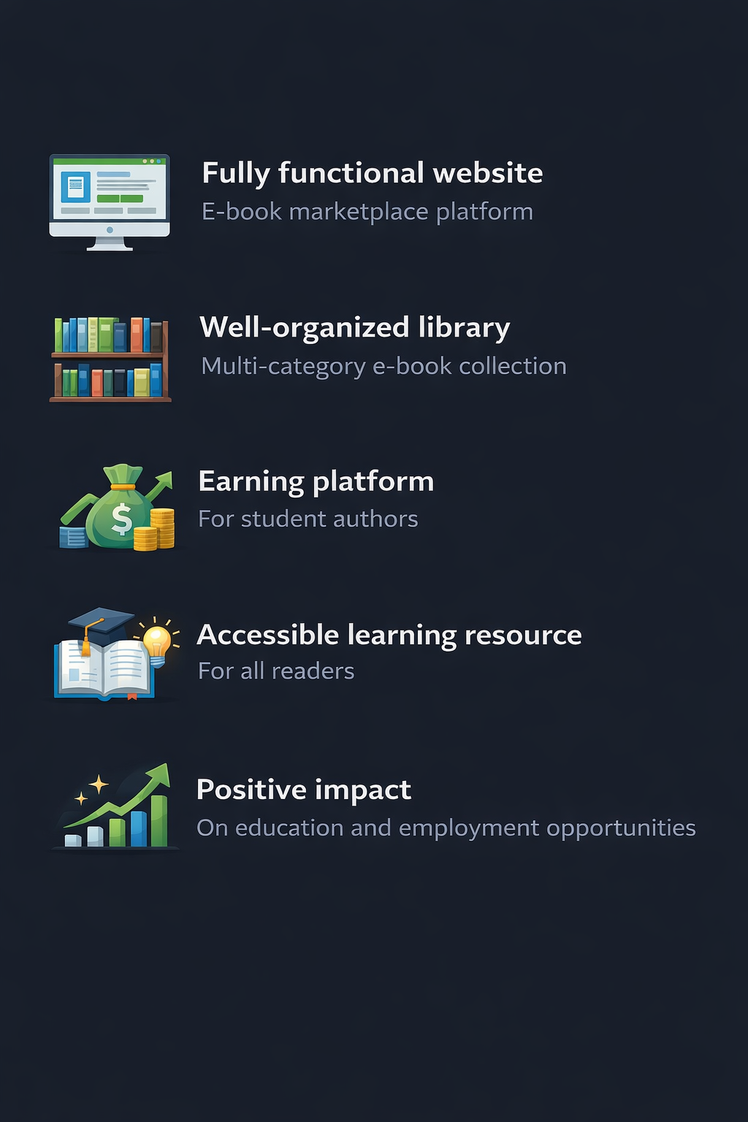
Expected Outcomes

Slide 9
Conclusion
• Unique combination
Reading, writing, and earning
• Addresses real problems
In digital publishing
• Supports education & creativity
And entrepreneurship

